Slide 1
BITS Pilani presentation
K.Anantharaman
kanantharaman@wilp.bits-pilani.ac.in
17-24 Feb 24
SE ZG544 S2-23-24 Agile Software Process
Notes:
W starstarts

Slide 2
Module-5 Agile Requirements & Agile Estimation
17-24 Feb 24
Agile Software Process

Slide 3
Key Points taken from the recorderd presentation
Requirements management is challenging - 37% of project issues are due to requirements.
Agile iterative and incremental development helps manage requirements risk better than waterfall.
Requirements are organized into themes, features, epic user stories, user stories, and tasks.
Estimation in agile is relative, not quantitative. User stories are relatively sized using the Fibonacci sequence.
Estimation is done by consensus, often using techniques like planning poker.
Requirements are prioritized by calculating relative priority as value/effort. Higher value, lower effort requirements get higher priority.
The prioritized requirements are used to build the product roadmap and product backlog.
Requirements are managed at every stage - product roadmap, release planning, and sprint planning.
Requirements can change continuously in agile until the last sprint/release.
In summary, agile approaches requirements iteratively, relatively sizes and prioritizes them, and uses them to drive development in an incremental way via the roadmap, releases, and sprints.

Slide 4
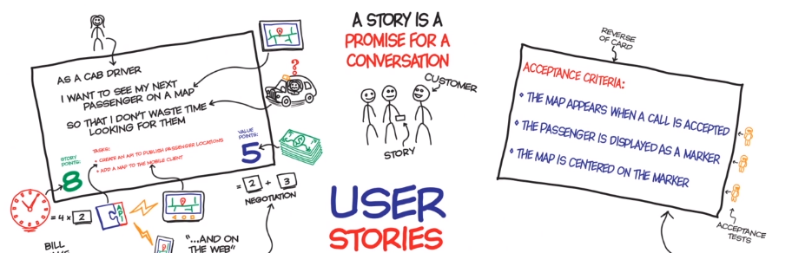
Agile Requirements-1
(Effective User Stories - CCC)
17-24 Feb 24
SE ZG544 S2-23-24 Agile Software Process
Notes:
ToLEVELp

Slide 5
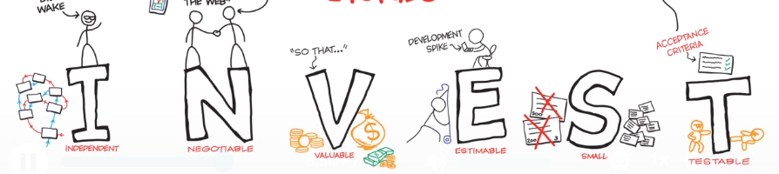
Effective User Stories (CCC & INVEST Guide)
17-24 Feb 24
SE ZG544 S2-23-24 Agile Software Process

Slide 6
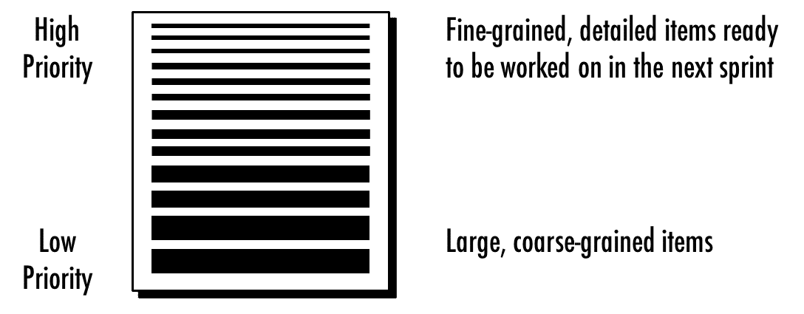
Product Backlog
D E E P
Detailed Emergent Estimatable Prioritized
Themes, Epic
17-24 Feb 24
SE ZG544 S2-23-24 Agile Software Process

Slide 7
Question? (Apply INVEST Test)
(Real Estate Project - House Construction)
As a home owner, I want my house to have walls so that the house will be wind-proof.
As a home owner I want the house to have a roof so that it will be rain proof.
As a property developer I want to build a mansion because mansions sell well in this area.
As a builder I want to use cement from Acme Corporation because it's run by my sister.
As a property developer I want the house to look great so that it will sell
Q1---?
17-24 Feb 24
Ref: The Agile Sketchpad,O'Reilly Media Dawn Griffiths ,David Griffiths
SE ZG544 S2-23-24 Agile Software Process

Slide 8
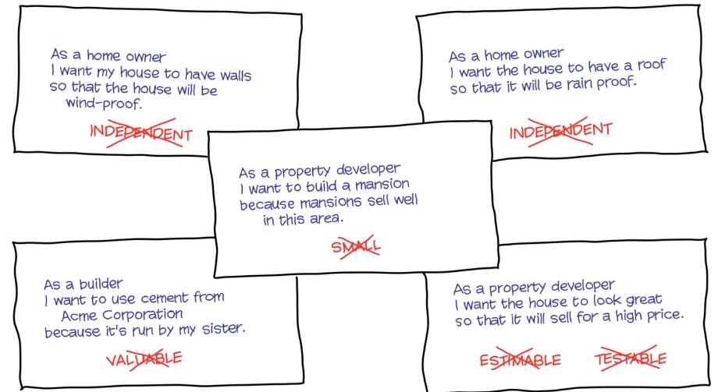
Q&A (Apply INVEST Test)-Answer

Slide 9
Approaches to User Stories Prioritization
Customer Valued Prioritization
Kano Analysis (Satisfied, Dissatisfied, Exciters)
MoSCoW Technique (Must have, Should have, Could have, Wont have)
Relative Prioritization
Business Value Vs Risk Vs Effort
Relative Weighting Prioritization (Value/Cost)
Story Mapping
17-24 Feb 24
SE ZG544 S2-23-24 Agile Software Process

Slide 10
Agile Estimation – Story Point Estimation
17-24 Feb 24
SE ZG544 S2-23-24 Agile Software Process

Slide 11
Agile Estimation
Absolute Estimation
Relative Estimation
Fibonacci Sequence (1,2,3,5,8,13,21,34,55, ……)
Story Point
Value Point
Velocity
Average Velocity
BFTB (Bank For The Buck)= Value Point /StoryPoint
17-24 Feb 24
SE ZG544 S2-23-24 Agile Software Process

Slide 12
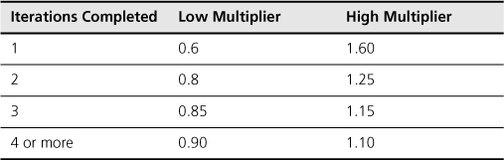
Velocity
Velocity = Number of story points the team can deliver in an iteration/Sprint (OR)
Calculating Velocity:
Sprints | Number of Story points Delivered
Sprint-1 | 16
Sprint-2 | 15
Sprint-3 | 17
Sprint-4 | 20
1.Average = (16+15+17+20) / 4 = 17 Story points
2. Give it as a range
Velocity is a rolling average. That means that the velocity may increase or decrease depending on what happens with the team.
After some iterations the velocity will become stable.
17-24 Feb 24
SE ZG544 S2-23-24 Agile Software Process

Slide 13
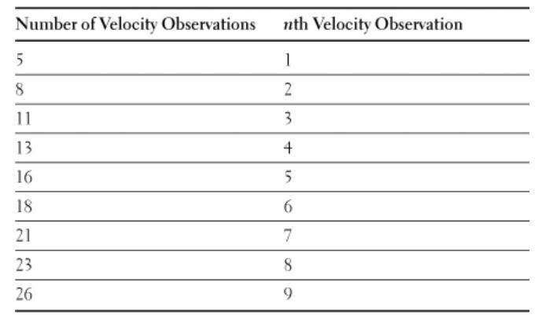
High-confidence forecast- Example
16
20 20 25 26 26 26 28
Velocity of completed 8 sprints
:20, 25, 28, 26, 16, 20, 26, 26
90% Confidence Interval
Sorted Velocity List
20 ➔ Lower confidence, certainly we will do
23 ➔ Mean Velocity – We will get here
26 ➔ Upper confidence, Most we could expect
Use the nth Lowest and the nth Highest Observation of a Sorted List of Velocities to Find a 90% Confidence Interval
Source: Succeeding with Agile SW development by Mike Cohen
17-24 Feb 24
SE ZG544 S2-22 Agile SW Process

Slide 14
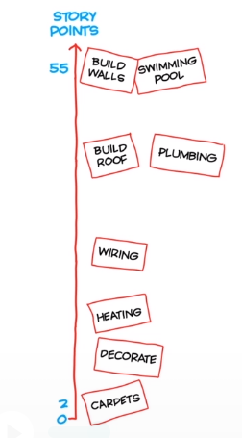
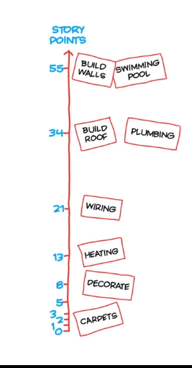
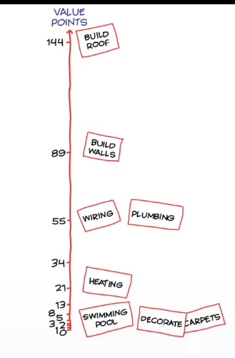
Agile Estimation - User Stories Example-Housing Project
User Stories
Build Walls
Carpets
Decorate
Build Roof
Wiring
Plumbing
Swimming Pool
Heating
Fibonacci Sequence (1,2,3,5,8,13,21,34,55, ……)
17-24 Feb 24
SE ZG544 S2-23-24 Agile Software Process
Ref: The Agile Sketchpad,O'Reilly Media Dawn Griffiths ,David Griffiths

Slide 15
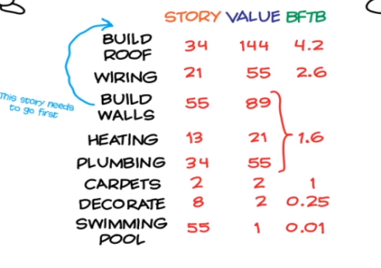
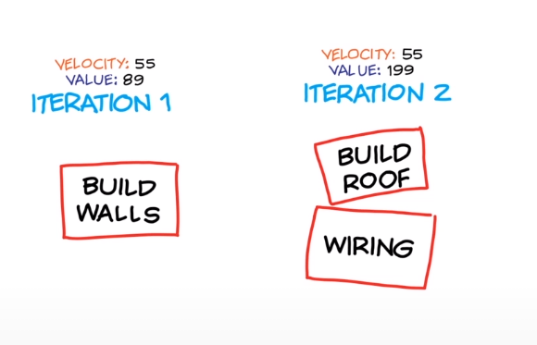
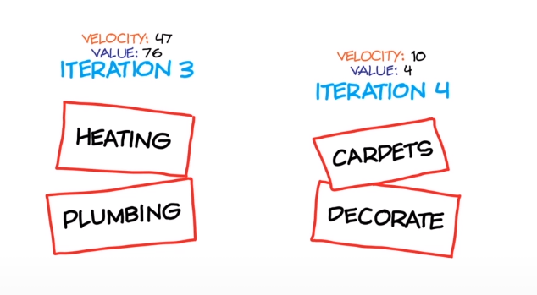
Agile Estimation
Cost: $20000, Cost/Value= 20000/89 = $225
Cost: 199*225=$44000
Iteration-5
Swimming Pool
Cost :76*225 =$17000
Cost: 4*225=900
17-24 Feb 24
SE ZG544 S2-23-24 Agile Software Process
Ref: The Agile Sketchpad,O'Reilly Media Dawn Griffiths ,David Griffiths

Slide 16
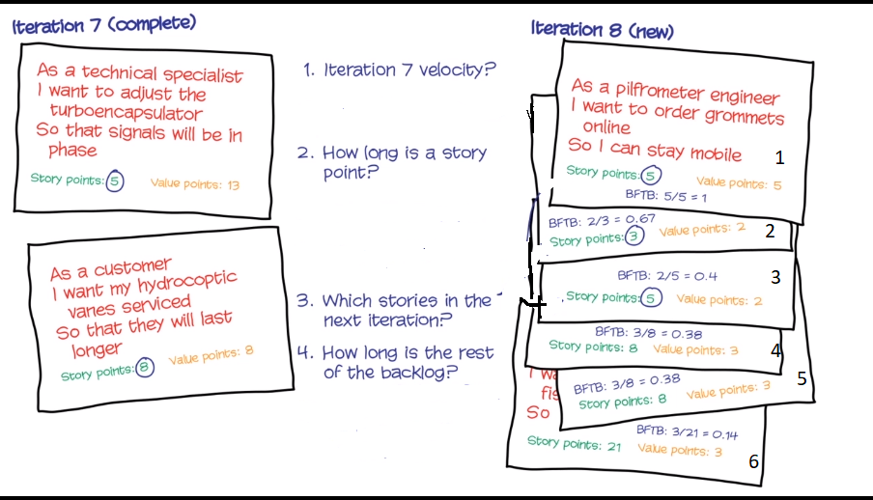
Estimation Exercise
(Iteration Length = 2 weeks (10 Days, 8hrs Per day)
https://forms.gle/Zkg8aYpUHdoGa6UV7
17-24 Feb 24
SE ZG544 S2-23-24 Agile Software Process
Ref: The Agile Sketchpad,O'Reilly Media Dawn Griffiths ,David Griffiths

Slide 17
Estimation Exercise
(Iteration Length = 2 weeks (10 Days, 8hrs Per day)
8+5 = 13 Story Points
80 hrs = 13 Story Points
1 Story Point = 80/13
= 6.15hrs
Total SP= 5+3+5+8+21
=50 Points
Time = 50*6.5hrs=307.5 hrs
17-24 Feb 24
SE ZG544 S2-23-24 Agile Software Process
Ref: The Agile Sketchpad,O'Reilly Media Dawn Griffiths ,David Griffiths

Slide 18
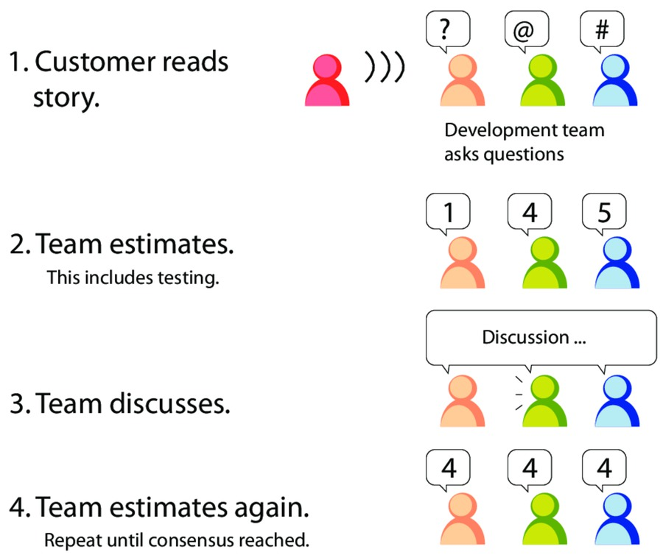
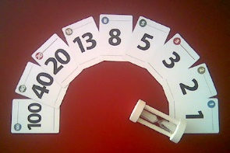
Planning Poker
How User Stories are estimated by the team?
-
Estimator | Round1 | Round 2
Team member-1 | 3 | 5
Team member-2 | 8 | 5
Team member-3 | 2 | 5
Team member-4 | 5 | 8
Ref: The Agile Samurai by Jonathan Rasmusson Published by Pragmatic Bookshelf, 2010
17-24 Feb 24
Image source: https://www.pmi.org/learning/library/agile-project-estimation-techniques-6110
SE ZG544 S2-23-24 Agile Software Process

Slide 19
Module – Agile Requirements & Agile Estimation – Additional Notes
17-24 Feb 24
SE ZG544 S2-23-24 Agile Software Process

Slide 20
Requirements Gathering in Waterfall Method
In Waterfall model, We tend to describe upfront how the entire product/system will work and document them.
PRD or SRS or CRS
The problem with gathering requirements as documentation isn’t one of volume—it’s one of communication. It’s just really easy to misinterpret what someone wrote.
Other Issues:
Lengthy Process (1 to 3 months), Sometime Project wont get started
Requirement change is hard, especially late in the cycle
Bad guesses and wrong assumptions and so on ….
17-24 Feb 24
SE ZG544 S2-23-24 Agile Software Process

Slide 21
Requirements Gathering in Agile
In Agile Projects, User Stories are the main way to track the information or requirements, of the project.
User Stories tell us about:
What customer the wants the team to do?
How valuable the work is?
How long it is likely to take completed?
User stories are fundamental unit of product development in Agile environments
User stories describe single feature which enable rapid iteration.
17-24 Feb 24
SE ZG544 S2-23-24 Agile Software Process

Slide 22
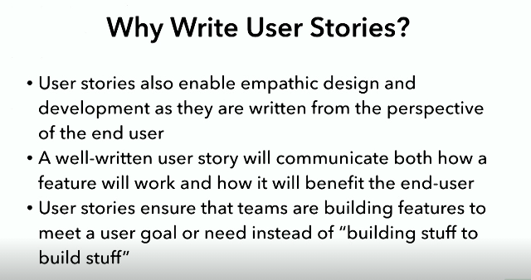
Empathic design is a user-centered design approach
Ref: Writing User Stories By Ryan Harper O'Reilly Media -Video
17-24 Feb 24
SE ZG544 S2-23-24 Agile Software Process

Slide 23
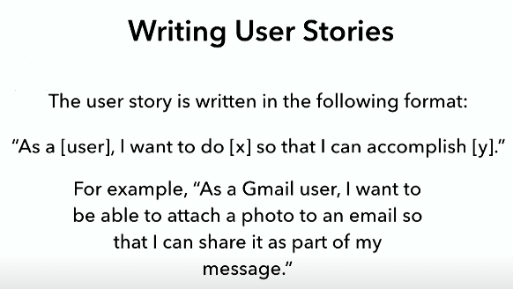
Another User Story format and Examples
Who?
What?
Why?
Note: If the user story involves a frontend (user-facing) design component, the design files should be included with the user story
Ref: Writing User Stories By Ryan Harper O'Reilly Media -Video
17-24 Feb 24
SE ZG544 S2-23-24 Agile Software Process

Slide 24
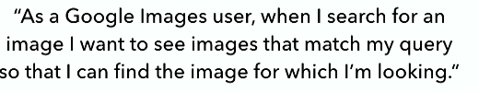
User Story Examples
A user story for returning images in Google Image search.
Note that, user story does not focus on how the images will be returned or displayed, but rather on end user’s goal and needs.
Ref: Writing User Stories By Ryan Harper O'Reilly Media -Video
17-24 Feb 24
SE ZG544 S2-23-24 Agile Software Process

Slide 25
Writing Acceptance Criteria for User Stories
The second part of the user story , the acceptance criteria, explains how the feature will work.
The acceptance criteria consists of series of boolean statements (true or false), such as “ When [x] happens, [y] should happen
17-24 Feb 24
SE ZG544 S2-23-24 Agile Software Process

Slide 26
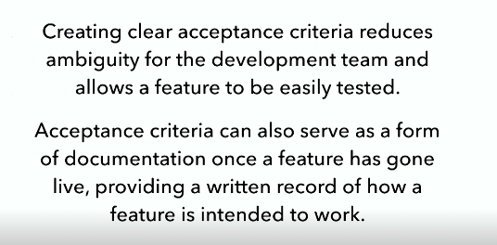
Acceptance Criteria/Conditions of Satisfaction
Ref: Writing User Stories By Ryan Harper O'Reilly Media -Video
17-24 Feb 24
SE ZG544 S2-23-24 Agile Software Process

Slide 27
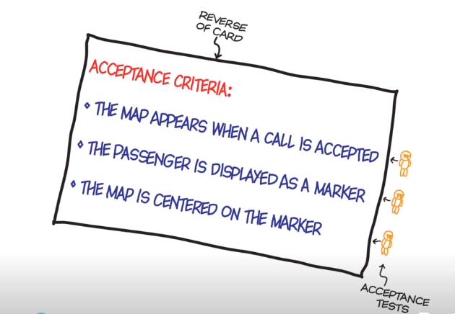
Examples Acceptance Criteria
Back of the User Story card
For example for an Gmail user,
“ When the user saves an email that has not been sent, it should be stored in the user’s Drafts folder”
Outcome: Email stored in Drafts (Yes) or Not (No)
17-24 Feb 24
SE ZG544 S2-23-24 Agile Software Process
Ref: The Agile Sketchpad,O'Reilly Media Dawn Griffiths ,David Griffiths

Slide 28
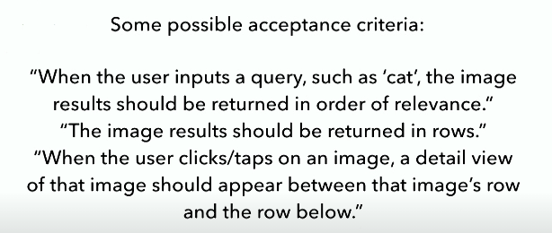
Acceptance Criteria for Google Image search
1. Relevance:
The image most related to user query appears first, the images least related to user query appears last
2. Rows: Layout function
3. Tap on Image: how user will interact with the image
Ref: Writing User Stories By Ryan Harper O'Reilly Media -Video
17-24 Feb 24
SE ZG544 S2-23-24 Agile Software Process

Slide 29
Elements of Good User Stories
Bill Wake came up with the INVEST acronym for good user story.
Good user stories also have the following characteristics:
Independent
Negotiable
Valuable
Estimatable
Small
Testable
The Agile Samurai by Jonathan Rasmusson Published by Pragmatic Bookshelf, 2010
17-24 Feb 24
SE ZG544 S2-23-24 Agile Software Process

Slide 30
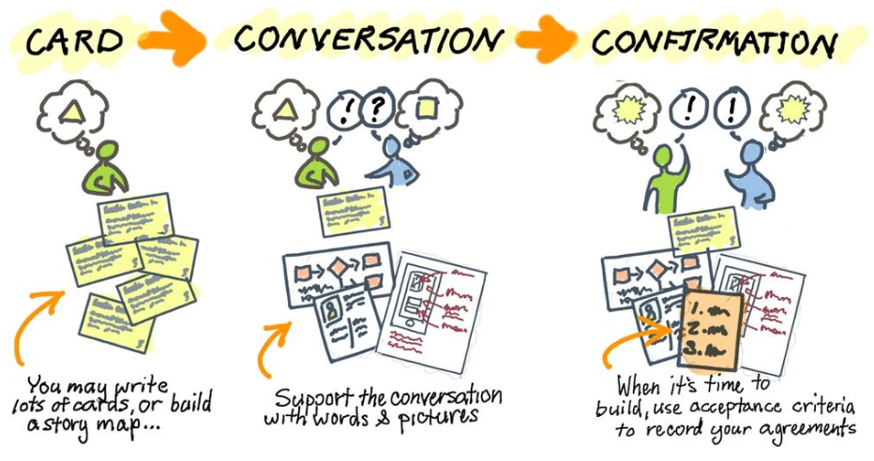
The 3 Cs- Story Process
In the book Extreme Programming Installed, Ron Jeffries et al. (Addison-Wesley Longman Publishing) describe the story process best:
Card:
Write what you’d like to see in the software on a bunch of index cards.
Conversation
Get together and have a rich conversation about what software to build.
Confirmation
Together agree on how you’ll confirm that the software is done.
17-24 Feb 24
SE ZG544 S2-23-24 Agile Software Process

Slide 31
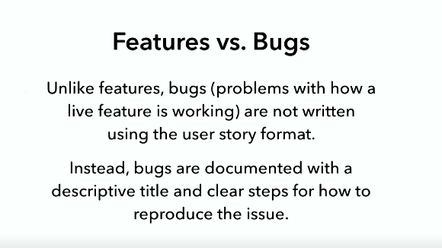
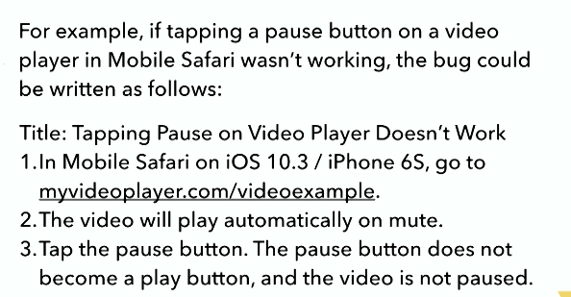
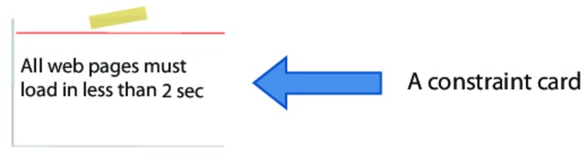
Difference Between User Story, Bugs, Constraints
Constraints
Story: Website must be super fast
Story: Design should look really good – Constraint Card
Stories like these, we call constraints.
But they are important because they describe characteristics our customers would like to see in their software.
For example, The Website must be super fast can be written like this.
17-24 Feb 24
SE ZG544 S2-23-24 Agile Software Process
Ref: Writing User Stories By Ryan Harper O'Reilly Media -Video

Slide 32
How to take care of Frontend Design?
If a user story includes a new design, the design files illustrating that design (including any interactions) are included with user story.
Design tools: Adobe Photoshop, Sketch and Invision
Design files: Wireframes, Mockup, Prototypes
https://justcoded.com/blog/wireframe-mockup-and-prototype-whats-the-difference/
17-24 Feb 24
SE ZG544 S2-23-24 Agile Software Process

Slide 33
Story Grooming Meeting
Story grooming meetings give the engineering team a chance to review user stories before they are scheduled for a development sprint.
Story grooming meetings are critical for securing the development team's buy-in.
The team is given a chance to ask the questions that would normally arise during sprint planning:
What should we do if the user enters invalid data here?
Are all users allowed to access this part of the system?
What happens if…?
The team provides feedback on the feasibility, viability, and size of each feature and may provide alternate solutions/ or identify previously unforeseen prerequisites or roadblocks for the user needs identified in the user stories.
Ref: Writing User Stories By Ryan Harper O'Reilly Media -Video
17-24 Feb 24
SE ZG544 S2-23-24 Agile Software Process

Slide 34
Agile Estimation
17-24 Feb 24
SE ZG544 S2-23-24 Agile Software Process

Slide 35
Absolute Estimation
We estimate our work in hours, days, and weeks.
We use all the knowledge and experience at hand to make a guess about the amount of time it is going to take.
Estimation is approximate and not accurate
Absolute estimation:
Estimating in absolute values (Examples, days, weeks, months or KMs, Miles ….)
Absolute values are not easier to judge
People are not good at absolute estimation
17-24 Feb 24
SE ZG544 S2-23-24 Agile Software Process

Slide 36
Relative Estimation
Agile team use relative estimation.
Relative estimating compares what you don't know against what you do know.
For example, You might not be able to guess how much a truck weighs, but if you saw the truck, you can probably guess how many cars equal a truck.
A “customer search” story, as it probably involves double the effort to implement than a simple “Login user” story.
Relative estimation is easier to judge than absolute values.
This means judging how big or complex tasks are with respect to other tasks
This estimation in not designed to be precise.
But that doesn't mean it's useless. Instead it gives you a starting point, a way to start the discussion on what it takes to deliver your stories.
17-24 Feb 24
SE ZG544 S2-23-24 Agile Software Process

Slide 37
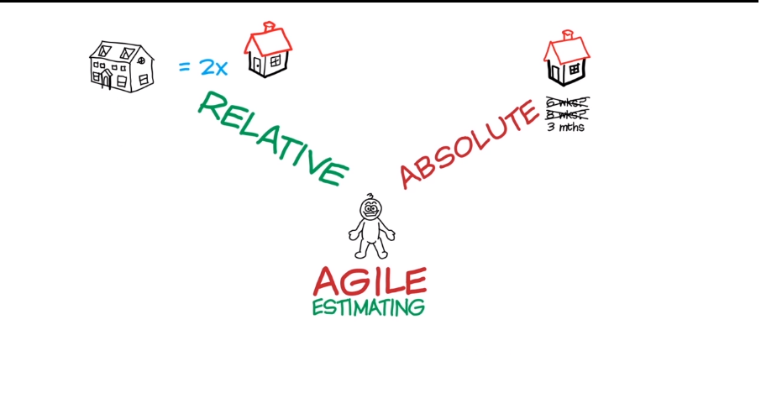
Absolute vs Relative Estimation
As an analogy, it is much easier to say that Delhi to Bangalore is twice the distance of Mumbai to Bangalore than saying that the distance from Delhi to Bangalore is 2061 kms.
17-24 Feb 24
SE ZG544 S2-23-24 Agile Software Process
Ref: The Agile Sketchpad,O'Reilly Media Dawn Griffiths ,David Griffiths

Slide 38
Why Agile team use Relative Estimation?
Relative estimation takes away from the false comfort of precision.
The team is accepting the fact that the estimates will be imprecise.
That way we can start talking about what it takes to deliver this story instead spending too much time on estimates.
Agile uses relative estimating is that it keeps the team from confusing estimates from commitments.
An estimate is the useful information you might give a co-worker. A commitment is something that you usually give to a supervisor. An estimate is a best guess. A commitment is often a worst case scenario. That's why for Agile planning, you want estimates and not commitments.
3. Relative sizing across stories tends to be much more accurate over a larger sample, than trying to estimate each individual story for the effort (in hours) involved.
17-24 Feb 24
SE ZG544 S2-23-24 Agile Software Process

Slide 39
Story Point Estimation
17-24 Feb 24
SE ZG544 S2-23-24 Agile Software Process

Slide 40
Story Point for Estimation
In Agile, we use relative estimation
We do this by comparing the time to take one story vs time to take another story without using absolute estimates
We do this by using Story points.
We will have an exponential number sequence.
Something like 1,2,3,5,8, 13 ….. These are the points for each of the stories.
When we estimate with story points, we assign a point value to each item.
The raw values we assign are unimportant. What matters are the relative values. A story that is assigned a 2 should be twice as much as a story that is assigned a 1. A 2 point story is 2/3 of 3 point story.
Instead of assigning 1, 2 and 3, that team could instead have assigned 100, 200 and 300. Or 1 million, 2 million and 3 million. It is the ratios that matter, not the actual numbers.
17-24 Feb 24
SE ZG544 S2-23-24 Agile Software Process

Slide 41
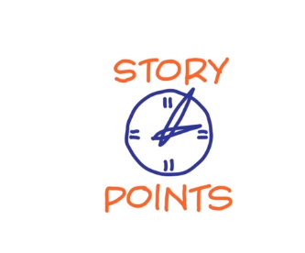
What does a Story Point represent ?
Represents the amount of effort or fixed period of time required to implement a user story. (Size)
Story Point is not an estimate of the amount of time it takes to implement a Story.
Some argue that it is a measure of complexity, but that is only true if the complexity or risk involved in implementing a user story translates into the effort involved in implementing it.
17-24 Feb 24
SE ZG544 S2-23-24 Agile Software Process

Slide 42
Fibonacci series as Story points
The most common way is to estimate a user story is to use the Fibonacci series (1, 2, 3, 5, 8, 13, 21, 34, 55….. with each number the sum of the preceding numbers.
Why Fibonacci?
It’s because numbers that are too close to one another are impossible to distinguish as estimates.
In Fibonacci series, after the 2 (which is 100% bigger than one), each number is about 60% larger than the preceding value.
17-24 Feb 24
SE ZG544 S2-23-24 Agile Software Process

Slide 43
Predictability of User Stories Estimation
Small stories tend to result in a more accurate and reliable estimates.
Small stories reduces variability and improves predictability.
So, a 13 or 20-point story is likely much less predictable than several 2, 3, or 5-point stories.
Relative story point estimates using the Fibonacci sequence are, by design, increasingly less accurate for larger estimates – like the “cone of uncertainty”
17-24 Feb 24
SE ZG544 S2-23-24 Agile Software Process

Slide 44
Examples from Software Development-Story Points are relative
1 –QUICK TO DELIVER AND MINIMAL COMPLEXITY. AN HOUR
Example: add field to a form
2 –QUICK TO DELIVER AND SOME COMPLEXITY. MULTIPLE HOURS
Example: Add parameter to form, validation, storage
3 –MODERATE TIME TO DELIVER, MODERATE COMPLEXITY, POSSIBLE UNKNOWNS
Example: Migrate somewhat complex static CSS into a CSS pre-processor
5 –LONGER TIME TO DELIVER, HIGH COMPLEXITY, LIKELY UNKNOWNS
Example: Integrate with third-party API for pushing/pulling data, and link to user profiles in platform
8 –LONG TIME TO DELIVER, HIGH COMPLEXITY, CRITICAL UNKNOWNS
Example: Overhaul the layout/HTML/CSS/JS of a web application
13 –LONG TIME TO DELIVERY, HIGH COMPLEXITY, MANY CRITICAL UNKNOWNS
Example: Migrate application from an outdated data store to new DB technology and ORM
Ref: GenMan solution Inc.
17-24 Feb 24
SE ZG544 S2-23-24 Agile Software Process

Slide 45
How User Stories are estimated by the team?
One method is to play Planning poker game.
Planning poker helps give everyone a voice.
Combining of individual estimates through group discussion leads to better estimates
Combat Groupthink-meaning, the way that people tend to agree with the most popular idea.
Planning poker is a game where the development team estimates stories individually first (using a deck of cards with numbers like 1, 2, 3, 5, 13 …on them) and then compares the results collectively together after.
If everyone’s estimate is more or less the same, the estimate is kept. If there are differences, however, the team discusses them and estimates again until consensus is reached.
17-24 Feb 24
SE ZG544 S2-23-24 Agile Software Process

Slide 46
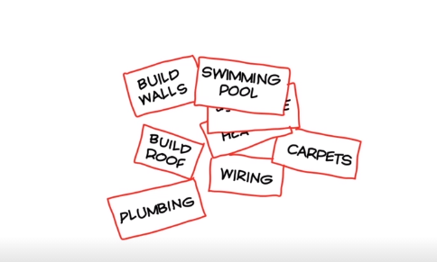
Story Point Estimation-An Example
Project : Build a House, Suppose we have the following bunch of user stories to be estimated. How do we start?
User stories
17-24 Feb 24
SE ZG544 S2-23-24 Agile Software Process
Ref: The Agile Sketchpad,O'Reilly Media Dawn Griffiths ,David Griffiths

Slide 47
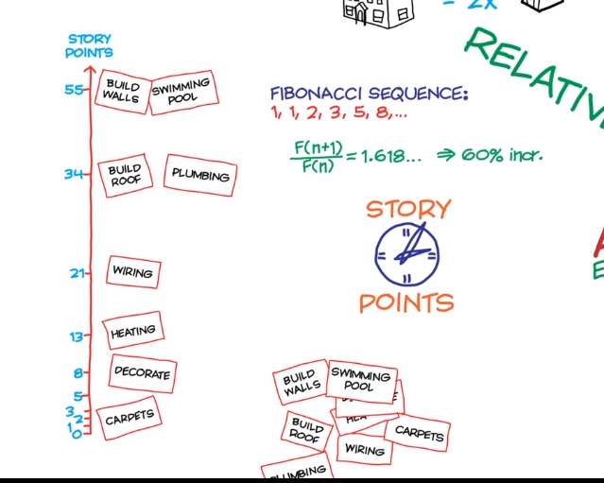
Story Point Estimation – Example
Steps:
The team may start with the smallest - Carpets Story , assign 2 points.
Next, for example, we may discuss the Build wall story. We agree on, it is 30 times larger than Carpet story. Hence, we assign 55 points in Fibonacci scale.
Then relatively, assign story points to other stories, Decorate, Heating etc.…
At this point, We do not know the effort of each story
17-24 Feb 24
SE ZG544 S2-23-24 Agile Software Process
Ref: The Agile Sketchpad,O'Reilly Media Dawn Griffiths ,David Griffiths

Slide 48
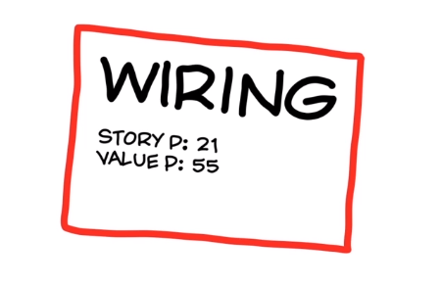
Value Point
A user Story has two estimates.
Story point – estimate of time
Value Point – estimate of value
Developers , the people who do the work, estimate User Stories in Story points,
Customer / Product owner estimates User Stories in Value Point, in the same way.
Story Card
Story Point : Amount of time/effort
Value Point : Worth to Customer
Agile is about delivering value early.
17-24 Feb 24
SE ZG544 S2-23-24 Agile Software Process
Ref: The Agile Sketchpad,O'Reilly Media Dawn Griffiths ,David Griffiths

Slide 49
Value Point Estimation – use the previous example
Highest Value Stories at the top of Product backlog
Relatively Value Stories
Lowest Value Stories at the bottom
17-24 Feb 24
SE ZG544 S2-23-24 Agile Software Process
Ref: The Agile Sketchpad,O'Reilly Media Dawn Griffiths ,David Griffiths

Slide 50
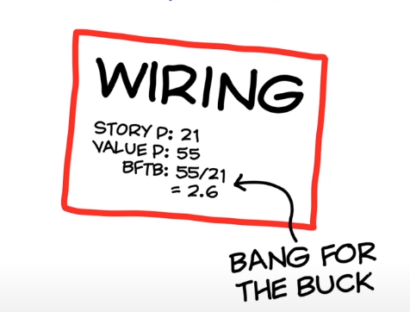
Bang For the Buck (BFTB) (OR) Priority
BFTB = Value Point divided by Story Point for each story
17-24 Feb 24
SE ZG544 S2-23-24 Agile Software Process
Ref: The Agile Sketchpad,O'Reilly Media Dawn Griffiths ,David Griffiths

Slide 51
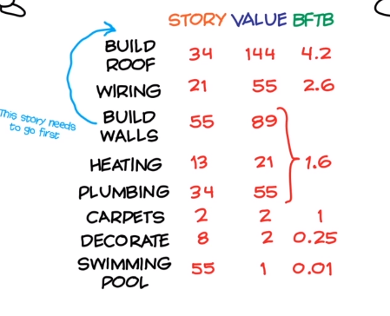
How stories are prioritized for each Iteration – by BFTB
Product Backlog
17-24 Feb 24
SE ZG544 S2-23-24 Agile Software Process
Ref: The Agile Sketchpad,O'Reilly Media Dawn Griffiths ,David Griffiths

Slide 52
Highest value delivered in early Iterations
Product Backlog
Suppose, Cost of this iteration-1 is 20000$;
= 20000/89 ~ 225$ Per Value Point.
For Iteration-2 = 225*199 ~ $44,000 (Highest value delivered)
17-24 Feb 24
SE ZG544 S2-23-24 Agile Software Process
Ref: The Agile Sketchpad,O'Reilly Media Dawn Griffiths ,David Griffiths

Slide 53
Value delivered decreases as iteration progress
Iteration-3 value = 76*$225 = $17,100; Iteration-3= 4*225=900
This is an example, but In reality, the value will decrease after many iterations, then customer can take a call to continue the project or not.
Over the period of time, after some iterations the velocity will become stable and value delivered will decrease.
17-24 Feb 24
SE ZG544 S2-23-24 Agile Software Process
Ref: The Agile Sketchpad,O'Reilly Media Dawn Griffiths ,David Griffiths

Slide 54
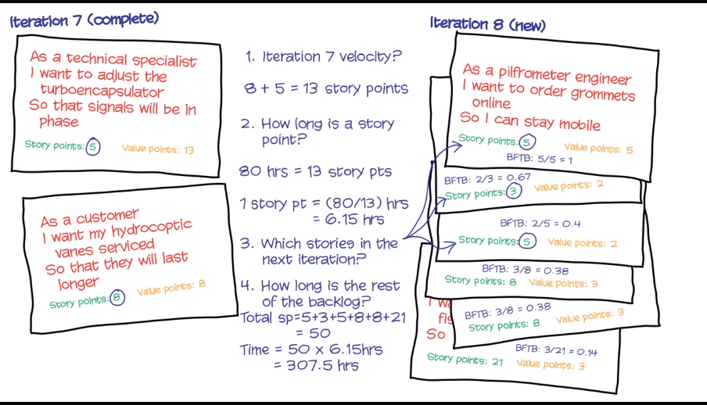
Estimation Exercise
(Assume, 2 week Iteration)
17-24 Feb 24
SE ZG544 S2-23-24 Agile Software Process
Ref: The Agile Sketchpad,O'Reilly Media Dawn Griffiths ,David Griffiths

Slide 55
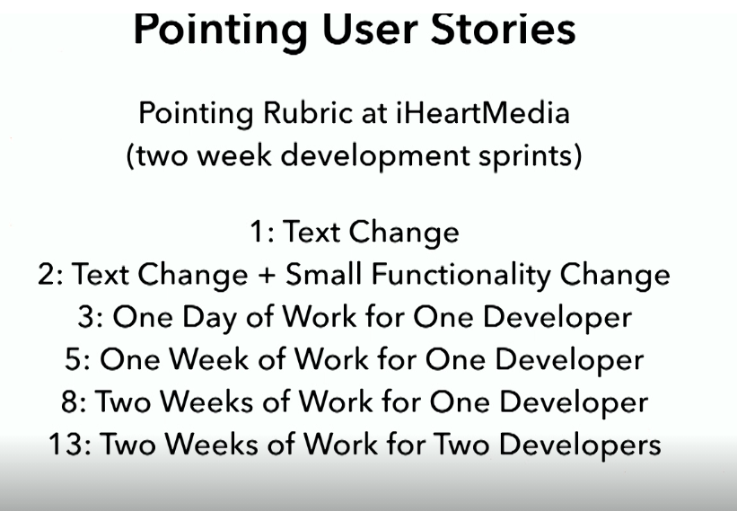
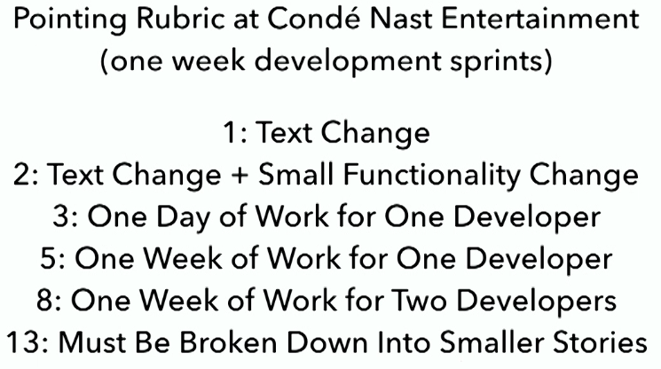
Story Points – Real Examples
Ref: Writing User Stories By Ryan Harper O'Reilly Media -Video
17-24 Feb 24
SE ZG544 S2-23-24 Agile Software Process

Slide 56
Other Estimation Techniques
17-24 Feb 24
SE ZG544 S2-23-24 Agile Software Process

Slide 57
Estimate by Analogy
Comparing a user story to others
“This story is like that story, so its estimate is what that story’s estimate was.”
Don’t use a single gold standard
Triangulate instead
Compare the story being estimated to multiple other stories
17-24 Feb 24
SE ZG544 S2-23-24 Agile Software Process

Slide 58
Triangulation
Confirm estimates by comparing the story to multiple
other stories.
Group like-sized stories on table or whiteboard
3 points | Story A
2 points | Story B | Story E | Story F
1point | Story C | Story D
17-24 Feb 24
SE ZG544 S2-23-24 Agile Software Process

Slide 59
Ideal Time
How long something would take:
If it’s all one person worked on
Had no interruptions
And everything you need is available.
The ideal time of a football game is 90 minutes
Four 15-minute quarters
The elapsed time is much longer (3+ hours)
It’s easier to estimate in ideal time.
It’s too hard to estimate directly in elapsed time.
Need to consider all the factors that affect elapsed time at the same time you’re estimating
17-24 Feb 24
SE ZG544 S2-23-24 Agile Software Process

Slide 60
Story Points Vs Ideal Time
Story points help drive cross-functional behavior
Story point estimates do not decay
Story points are a pure measure of size
Estimating in story points is typically faster
My ideal days cannot be added to your ideal days
Ideal days are easier to explain outside the team
Ideal days are easier to estimate at first
17-24 Feb 24
SE ZG544 S2-23-24 Agile Software Process

Slide 61
T –Shirt Sizing, Disaggregation
Level of Effort (LOE) or T-Shirt Sizing
T-shirt size,” “level of effort” (LOE), or “small, medium, large.” (Easy, but lack precision, inability to add up several stories into a meaningful measure.)
Extra small Small Medium Large Extra Large Extra Extra Large
1 point 2 points 3 points 5 points 8 points 13 points
Disaggregation
Breaking a big story into smaller stories ,we know how long the smaller stories take, So, disaggregating to something we know lets us estimate something bigger we don’t know
17-24 Feb 24
SE ZG544 S2-23-24 Agile Software Process

Slide 62
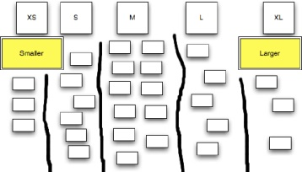
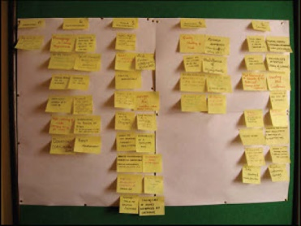
Affinity Grouping
Team members simply group items together that are like-sized, resulting in configuration similar to the one in figure.
17-24 Feb 24
Image source: https://www.pmi.org/learning/library/agile-project-estimation-techniques-6110
SE ZG544 S2-23-24 Agile Software Process

Slide 63
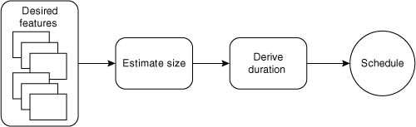
Estimating the duration of a project begins with estimating its size.
Sum the story-point estimates for all desired features we come up with a total size estimate for the project.
If we know the team’s velocity we can divide size by velocity to arrive at an estimated number of iterations.
We can turn this duration into a schedule by mapping it onto a calendar.
Source: Agile Estimating and Planning by Mike Cohn
Published by Addison-Wesley Professional, 2005
17-24 Feb 24
SE ZG544 S2-23-24 Agile Software Process

Slide 64
Re-estimating
Remembering that story points and ideal days are estimates of the size of a feature helps you know when to re-estimate.
You should re-estimate only when your opinion of the relative size of one or more stories has changed.
Do not re-estimate solely because progress is not coming as rapidly as you’d expected.
Let velocity, the great equalizer, take care of most estimation inaccuracies.
Source: Agile Estimating and Planning by Mike Cohn
Published by Addison-Wesley Professional, 2005
17-24 Feb 24
SE ZG544 S2-23-24 Agile Software Process

Slide 65
Thank you
17-24 Feb 24
SE ZG544 S2-23-24 Agile Software Process

